Slide 1


HOW TO SPEAK ARABIC OR ENGLISH
WITH PATIENT IN THE HOSPITAL

Slide 2


Slide 3
What are the conditions for communication operations.
What are the skills of speech.

Slide 4
To establish a good relationship with the PT. from admission time.
To have a cheerful face.
To be good looking.
To have ability to evaluate the PT. language and speech.

Slide 5
To have the ability to distinguish between speech – related diseases.
To have the ability to develop the appropriate treatment program for each case.

Slide 6
Communication skills :
Master expression and communication with your eyes and body language.
Communicate accurately and clearly.
Listen and give the speaker your full attention.
Accept difference.

Slide 7
Watch your tone of voice
Use the word “ I “ .
Avoid guessing .

Slide 8
What are the elements of a communication process:
Communication objective
Sender
Receiver
Method ( channel )
The massage
Communication environment.

Slide 9
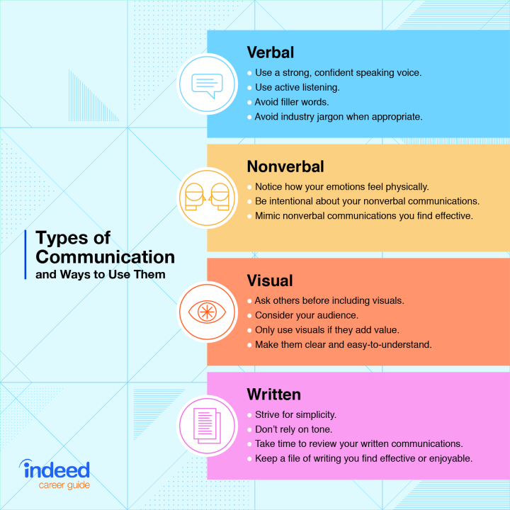
Type of communication:

Slide 10
Effective communication check list:
The goal is to develop trust.
Learn to listen.
Seek to understand the patients point .
Focus your communication on the goal.
Make communication a top priority.
Handle conflict immediately.

Slide 11
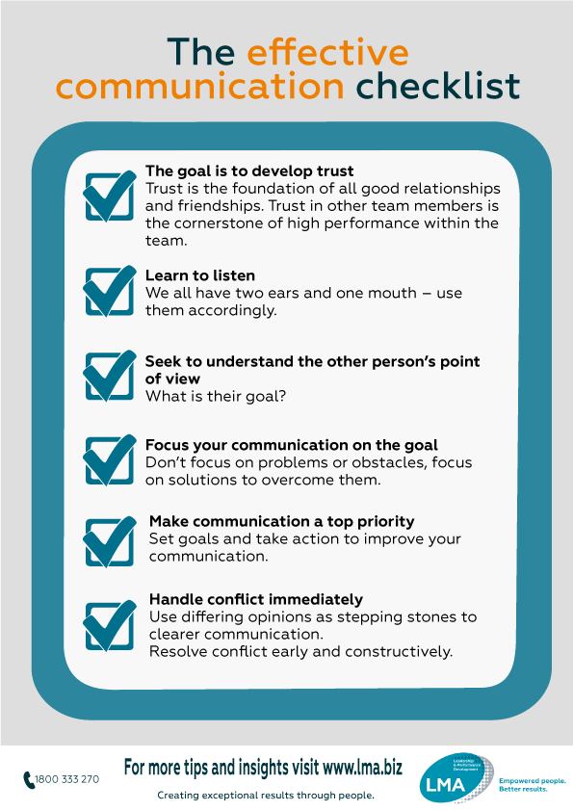

Slide 12
Work shop
Speak with patient while doing dressing and I.V fluid.

Slide 13
Doing grouping
Two person will deal together to communicate in both language.
Take easy sample to deal with it.
Practice at least 10 conversation.
To give home work doing as group.
First will read the words in English then will hear the voice in Arabic.
Will give example from both procedures
( dressing , I.V. fluid).

Slide 14
Preparation
Check the doctor order.
9 steps of PT. Identification.
Inform patient a bout the procedure.
Hand wash hygiene.
Prepare the trolley with items of ( dressing or I.V fluid ) , medication , medication sheet , anti septic fluid.
Provide patient safety.
Provide patient privacy.
Keep patient in comfortable position.
Do the procedure with sterile technique.

Slide 15

EXAMPLE : I.V FLUID
Good morning , I am going to fix I.V cannula to start your antibiotic.
صباح الخير ، راح نركب القسطرة الوريدية
علشان نبدا المضاد الحيوي.

Slide 16
I'm going to check your hand which one the best vein
راح نشيك علي اليد ايهم افضل وريد

Slide 17
I'm going to apply tourniquet
سوف نضع الرباط الضاغط

Slide 18
I will clean with alcohol swab
سوف انظف المنطقة بالمعقم

Slide 19
I will insert the cannula in to the vein
سوف ادخل القسطرة في الوريد

Slide 20
I will fix the plaster with date
And time
سوف اضع اللاصق مع التاريخ والوقت

Slide 21
EXAMPLE : Dressing
Good morning: I will do dressing
for your wound
صباح الخير سوف اعمل غيار علي الجرح

Slide 22
I will remove the old dressing
gently
سوف ازيل الغيار القديم برفق

Slide 23
I will clean the wound from inside to outside
سوف انظف الجرح من الداخل الي الخارج

Slide 24
I will dry the wound
سوف انشف الجرح

Slide 25
I will apply medicine gently
سوف اضع العلاج برفق

Slide 26
I will cover the wound with dry
Gauze
سوف اغطي الجرح بالشاش

Slide 27
I will secure the dressing with plaster
سوف اثبت الغيار بالبلاستر

Slide 28
Some word need to use:
Open your hand
افتحي ايدج

Slide 29
Close your hand
سكري ايدج

Slide 30
Take deep breath
خدي نفس عميق

Slide 31
There is pain
هل يوجد عوار

Slide 32
Take your medicine
خدي العلاج

Slide 33
There is injection ( …..)
في ابرة

Slide 34
THANK YOU
شكرا

